Slide 1
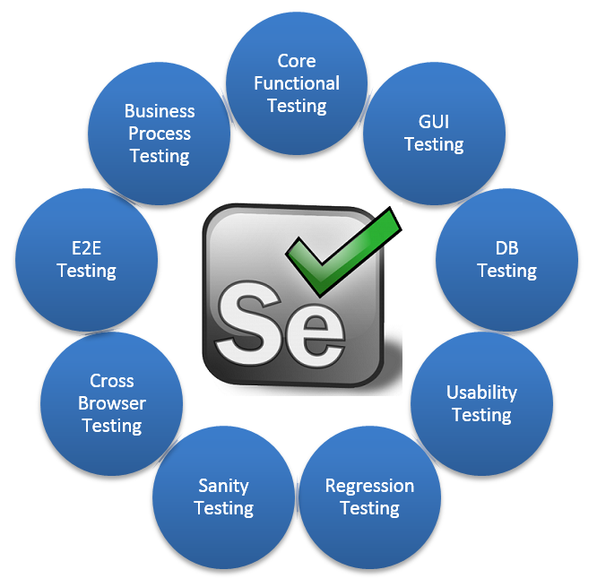

Selenium Automation Testing Tool
for
CrowSoft
It is an open source project driver by Apache Foundation.
Free to use for both individual and Companies.
Conduct test on any browsers like Firefox,
Chrome, Internet Explorer, Opera and Safari.
Selenium runs on all popular operation systems like Windows, Linux, Mac Ubuntu.
Can write Selenium testing script in any programming language like Python, Java, C#, .Net, Perl and Php.

Slide 2
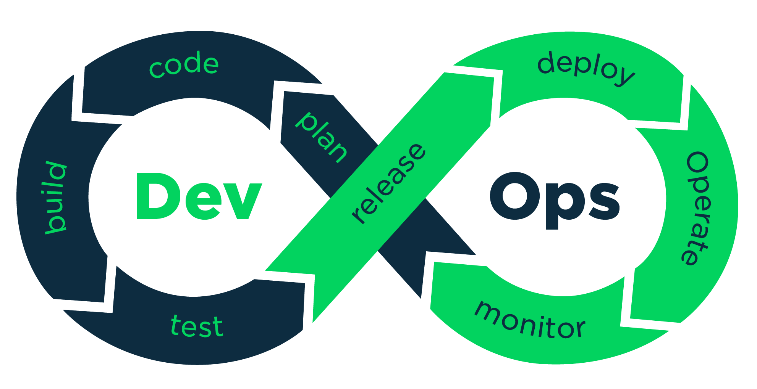


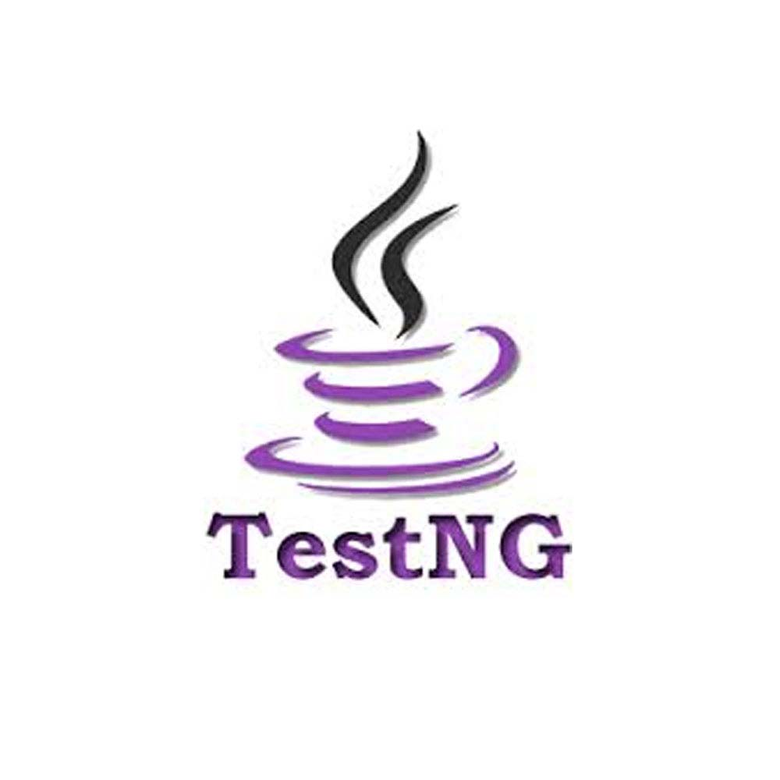



Selenium forms an integral part of Continues testing phase in DevOps life Cycle.
Selenium can easily integrated with lots of open source tools like Jenkins, TestNG, Maven, JUnit

Slide 3



Selenium Automation Testing Pipeline
for
CrowSoft
On Linux
Selenium node
Selenium Grid (Distributed Systems)
On Windows
In Eclipse we will configure all the required selenium Webdrivers, and write test codes to test the Crowsoft, in any scripting programming language.
Push all the test scrip from local to central repository (GitHub).
Selenium node
Jenkins will all to perform Continuous testing of newly created testing codes or updated/modified testing codes, and send feedback notification through mails.
Configure Selenium Grid to run the test on different machine means distributed Systems or remote Systems.
On Android
Selenium node

